Slide 1
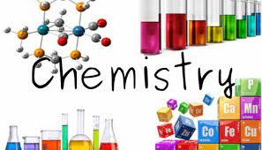

Slide 2
Worlds hardest toung twister?!!
(Prepare to blabbering 😈😈)
The sixth sick sheik's sixth sheep's sick .

Slide 3
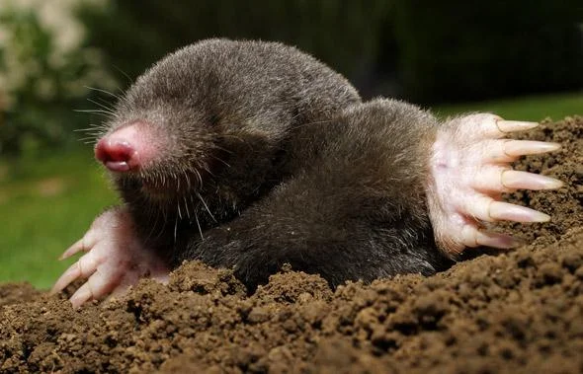

What is Mole Concept?
(Not a actual Mole Concept)

Slide 4
Mole Concept
Introduction
Mole is the measurement in chemistry.
It is used to express the amount of a chemical substance.
One mole is defined as the amount of substance of a system which contains as many entities like, atoms, molecules and ions as there are atoms in 12 grams of carbon – 12.

Slide 5
Example for Mole Concept
For example, let's take this equation.
2H2+ O2 → 2H2O.
The above reaction indicates that
(i) two molecules of hydrogen combine
with one molecule of oxygen to form
two molecules of water, or
(ii) 4 u of hydrogen molecules combine
with 32 u of oxygen molecules to form
36 u of water molecules.

Slide 6
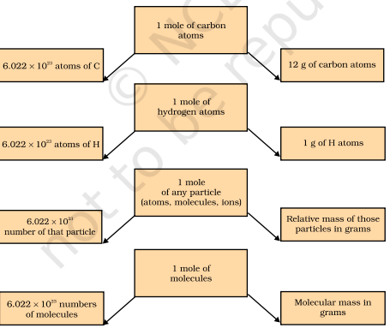
Relation between mole, avogadro number and mass

Slide 7


